Slide 1
Tolerances
Introduction to Engineering Design
© 2012 Project Lead The Way, Inc.

Slide 2
Tolerances
Variation is unavoidable
No two manufactured parts are identical – some degree of variation will exist
Tolerances are used in production drawings to control the manufacturing process and control the variation between copies of the same part
In particular, tolerances are applied to mating parts in an assembly
One advantage in using tolerances is that interchangeable parts can be used
Notes:
Without tolerances, copies of individual parts could vary significantly, disallowing the use of a copy of the part because is does not fit or does not operate properly within an assembly.

Slide 3
Tolerances
Large tolerance may affect functionality of part
Specify tolerances to ensure proper function
Small tolerance will affect the cost of the part
Cost generally increases with smaller tolerances
Will require precise manufacturing
Will require quality control with inspection and rejection of parts
Do not specify a tolerance that is smaller than necessary!
Notes:
Without tolerances, copies of individual parts could vary significantly, disallowing the use of a copy of the part because is does not fit or does not operate properly within an assembly.

Slide 4
Tolerances
ANSI/ASME Standard Y14.5
Each dimension shall have a tolerance, except those dimensions specifically identified as reference, maximum, minimum, or stock. The tolerance may be applied directly to the dimension or indicated by a general note located in the title block of the drawing.

Slide 5
Tolerances
A tolerance is an acceptable amount of dimensional variation that will still allow an object to function correctly.

Slide 6
Tolerances
Three basic tolerances that occur most often on working drawings are:
limit dimensions
bilateral tolerance
unilateral tolerance

Slide 7
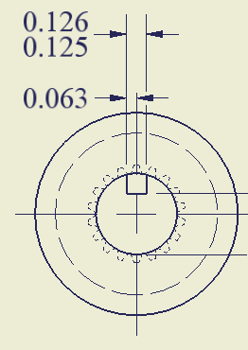
Limit Dimensions
Provide an upper limit and lower limit for the dimension.
Any size between or equal to the upper limit and/or lower limit is allowed
The upper limit dimension is 0.126
The lower limit dimension is 0.125

Slide 8
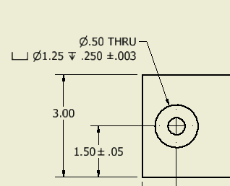
Bilateral Tolerance
Provides an equal allowable variation, larger and smaller
Uses a plus/minus (±) symbol to specify the allowable variation
Counter bore depth can be .003 larger or smaller than .25
Hole location can be .05 larger or smaller than 1.50

Slide 9
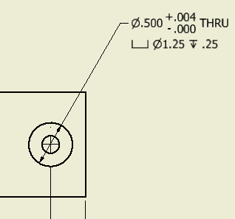
Unilateral Tolerance
Provides an allowable variation in only one direction (either larger or smaller)
Uses separate plus (+) and minus (–) signs
The hole diameter may vary .004 larger but may not be smaller than .500

Slide 10
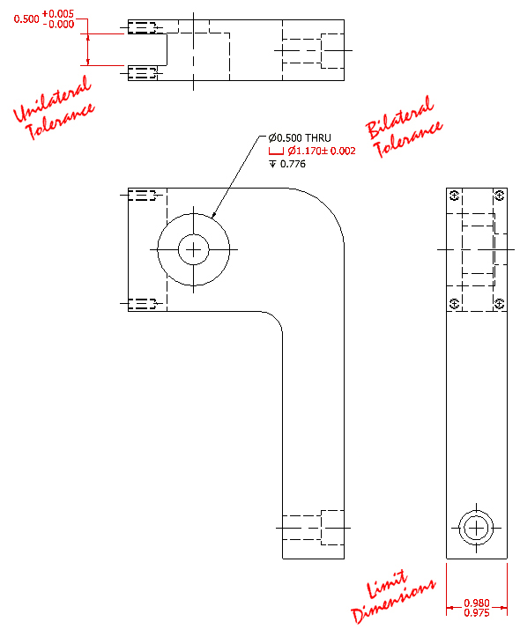
Tolerances
Identify the type of tolerance displayed in red
Limit dimensions
Bilateral
Unilateral
Notes:
Have students identify each type of tolerance displayed in red. Start with the upper left. Have students offer their answers, then click to reveal the correct tolerance type. Proceed to middle red dimension, then lower right dimension.

Slide 11
Definitions
Specified Dimension is the target dimension from which the limits are calculated
Specified dimension
1.50

Slide 12
Definitions
Limits are the maximum and minimum sizes shown by the toleranced dimension
Upper limit is the maximum allowable dimension
Lower limit is the minimum allowable dimension
Upper Limit = Specified Dimension + positive variance
1.55 = 1.50 + 0.05
Lower Limit = Specified Dimension + negative variance
1.45 = 1.50 + (– 0.05)

Slide 13
Definitions
Tolerance is the total variance in a dimension and is equal to the difference between the upper and lower limits.
Tolerance = Upper Limit – Lower Limit
0.10 = 1.55 – 1.45
Notes:
If a part is manufactured outside of the limits established by the tolerance, the part is said to be “out of tolerance”.

Slide 14
Calculating Tolerance
Tolerance
.010
- .05
+ .05
1.45
1.50
1.55
Lower Limit
Upper Limit
Tolerance = Upper Limit – Lower Limit
0.10 = 1.55 – 1.45

Slide 15
General Tolerances
General tolerances are tolerances that are assumed if no specific tolerance is given for a dimension
Typically tolerances are specified based on the number of digits to the right of the decimal point in a dimension
Shown on drawing
Linear Dimensions
X.X = ± .020
X.XX = ± .010
X.XXX = ± .005
Angles = ± .5°
Notes:
So, for example, using these general tolerances, a linear dimension specified with a precision of one digit to the right of the decimal point is specified to be manufactured within a variation of 0.02 larger or smaller than the specified dimension.
A part showing a specified length dimension of 3.64 must be manufactured to a length of between 3.63 and 3.65 (or equal to either of those values).

Slide 16
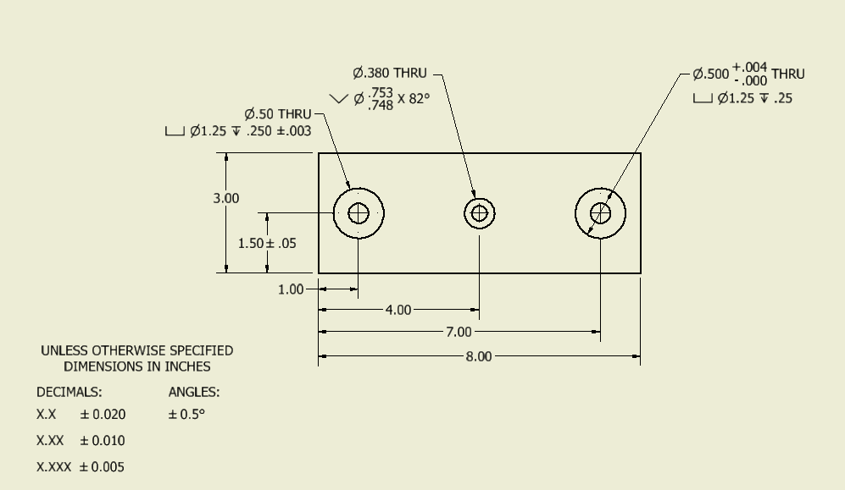
General Tolerances
Upper Limit = 3.00 + 0.010 = 3.010
Lower Limit = 3.00 + - 0.010 = 2. 990
Tolerance = Upper Limit – Lower Limit
= 3.010 – 2.990 = 0.020
Notes:
For example, the depth of a part is specified to be 3.00 with no indication of tolerance associated with the dimension. Therefore, the general tolerances apply. Because the dimension has two digits places to the right of the decimal point, the bilateral tolerance of +/- 0.010 applies. Therefore the upper limit is 3.010 and the lower limit is 2.990. This gives a tolerance of 0.020, the total allowed variation in the depth of the part.

Slide 17
Out of Tolerance
A manufactured part is said to be out of tolerance if the part is not within specified limits
Manufacturing facilities often institute quality control measures to help ensure that parts are within tolerance

Slide 18
Types of Fit
Clearance Fit limits the size of mating parts so that a clearance always results when mating parts are assembled
Interference Fit limits the size of mating parts so that an interference always results when mating parts are assembled
Transition fit occurs when two mating parts can sometimes have a clearance fit and sometimes have an interference fit

Slide 19
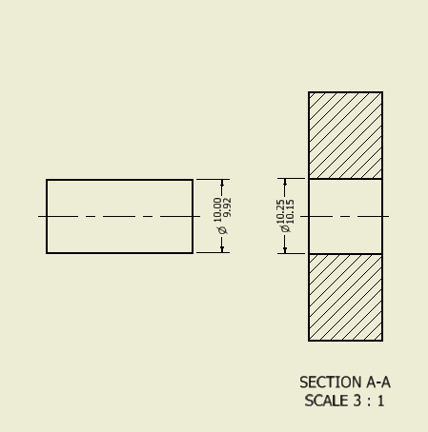
Types of Fit
Clearance Fit – Always a clearance between the axle and the opening
Notes:
Here, the maximum size of the axle is 10 and the minimum size of the hole is 10.15. If these parts are manufactured correctly, there will always be a clearance between these two parts when the axle is inserted through the hole.

Slide 20
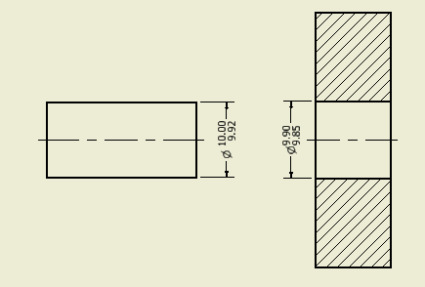
Types of Fit
Interference Fit - Always an interference between the axle and the opening
Notes:
In this case, the minimum size of the axle is 9.92, but the maximum size of the opening is 9.90. Therefore, if the parts are manufactured correctly, the axle will always be larger than the opening. This type of fit may be called a press fit or force fit such that the two parts must be pressed together in order to assemble them.

Slide 21
Definitions
Maximum material condition (MMC) is the condition of a part when it contains the largest amount of material.
The MMC of an external feature, e.g., the length of a plate, is the upper limit of the dimension
The MMC of an internal feature, e.g., the diameter of a hole, is the lower limit of the dimension

Slide 22
Definitions
Least material condition (LMC) is the condition of a part when it contains the smallest amount of material.
The LMC of an external feature, e.g., the length of a plate, is the lower limit of the dimension
The LMC of an internal feature, e.g., the diameter of a hole, is the upper limit of the diameter dimension

Slide 23
Definitions
Allowance is the minimum clearance or maximum interference between parts
Allowance = MMC internal feature
– MMC external feature

Slide 24
Calculate Allowance
Allowance = MMC internal feature
– MMC external feature
Allowance = 10.15 – 10.00
= 0.15
MMC
MMC
The maximum material condition (MMC) of the hole is 10.15 since the smaller hole will result in the most material in the part
The maximum material condition (MMC) of the axle is 10.00 since the larger axle will result in the most material in the part
Notes:
In the case of a clearance fit, the allowance is the smallest space between mating parts.

Slide 25
Calculate Allowance
Allowance = MMC internal feature
– MMC external feature
MMC internal feature
MMC
External feature
Allowance = 9.85 – 10.00
= – 0.15
The allowance, or maximum interference, is 0.15
Notes:
Have students calculate the allowance for this interference fit, then click to show the answer.
In the case of an interference fit, the allowance is negative and represents the maximum interference. In this case, the axle can be as much as 0.15 larger than the hole into which it fits. The larger the interference, the more difficult it is to force the axle into the hole.

Slide 26
A Note About Dimension Tolerance
In general, the more significant figures in the dimension, the tighter the tolerance
Overly precise dimensions and overly tight tolerances increase manufacturing costs
Specify dimensions only to the precision and tolerance necessary for the part to function properly
Notes:
For example, specifying a tight tolerance , say +/- .005 would be excessive and increase the cost of the coaster needlessly. However, specifying a tight tolerance on connections on an astronaut’s suit is necessary to ensure no leakage of gas.

