Slide 1
Introduction to Summary Statistics
Introduction to Engineering Design
© 2012 Project Lead The Way, Inc.

Slide 2
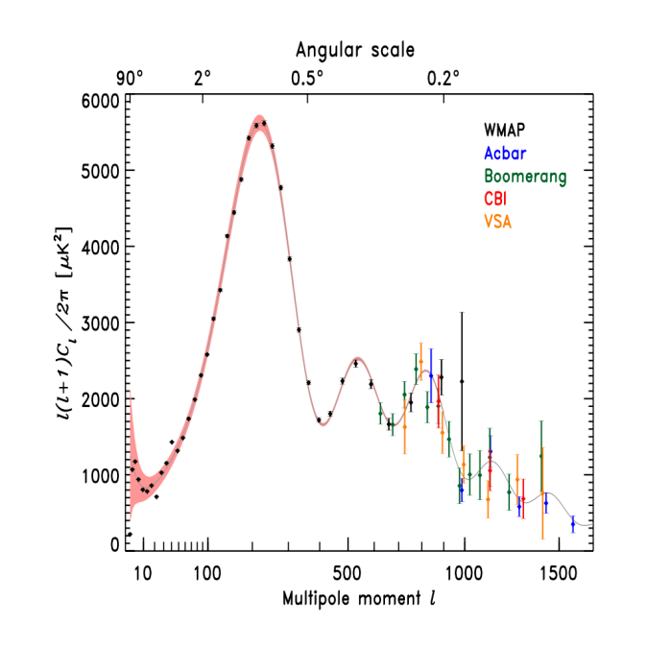
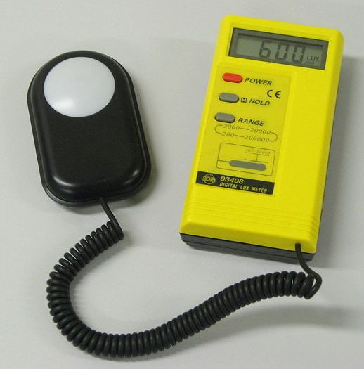
Statistics
The collection, evaluation, and interpretation of data
Statistical analysis of measurements can help verify the quality of a design or process

Slide 3
Summary Statistics
Central Tendency
“Center” of a distribution
Mean, median, mode
Variation
Spread of values around the center
Range, standard deviation, interquartile range
Distribution
Summary of the frequency of values
Frequency tables, histograms, normal distribution
Notes:
[click] The average value of a variable (like rainfall depth) is one type of statistic that indicates central tendency – it gives an indication of the center of the data. The median and mode are two other indications of central tendency.
But often we need more details on how much a quantity can vary. [click] Statistical dispersion is the variability or spread of data. The range, standard deviation, and interquartile range are indications of dispersion.
[click] Even more detail about a variable can be shown by a frequency distribution which shows a summary of the data values distributed throughout the range of values. Frequency distributions can be shown by frequency tables, histograms, box plots, or other summaries.

Slide 4
Mean Central Tendency
The mean is the sum of the values of a set of data divided by the number of values in that data set.
$$\text{μ}\text{ = }\frac{\sum{{\text{x}}_{\text{i}}}}{\text{N}}$$
Notes:
The mean is the most frequently used measure of central tendency. It is strongly influenced by outliers which are very large or very small data values that do not seem to fit with the majority of data.

Slide 5
Mean Central Tendency
$$\text{μ}\text{ = }\frac{\sum{{\text{x}}_{\text{i}}}}{\text{N}}$$
$\text{μ}$ = mean value
x_{i} = individual data value
$\sum{{\text{x}}_{\text{i}}}$ = summation of all data values
N = # of data values in the data set

Slide 6
Mean Central Tendency
Data Set
3 7 12 17 21 21 23 27 32 36 44
Sum of the values = 243
Number of values = 11
$$\text{μ}\text{ = }\frac{\sum{{\text{x}}_{\text{i}}}}{\text{N}}$$
243
Mean =
=
= 22.09
11

Slide 7
A Note about Rounding in Statistics
General Rule: Don’t round until the final answer
If you are writing intermediate results you may round values, but keep unrounded number in memory
Mean – round to one more decimal place than the original data
Standard Deviation – round to one more decimal place than the original data
Notes:
Ref: Elementary Statistics 7th edition by Bluman, McGraw-Hill 2009.

Slide 8
Mean – Rounding
Data Set
3 7 12 17 21 21 23 27 32 36 44
Sum of the values = 243
Number of values = 11
Reported: Mean =
$$\text{μ}\text{ = }\frac{\sum{{\text{x}}_{\text{i}}}}{\text{N}}$$
243
Mean =
=
$$\text{22.}\overline{\text{09}}$$
=
11
22.1
Notes:
In this case the result of the mean calculation is 22.09 with the 09 repeating. Notice that the bar above the 09 indicates a repeating decimal. Keep this number saved in your calculator if you will need it for future calculations (such as the standard deviation which we will present later).
Report the mean to one more decimal place than the original data. Since the original data is reported in whole numbers, report the mean to one decimal place or 22.1.

Slide 9
Mode Central Tendency
Measure of central tendency
The most frequently occurring value in a set of data is the mode
Symbol is M
Data Set:
27 17 12 7 21 44 23 3 36 32 21

Slide 10
Mode Central Tendency
The most frequently occurring value in a set of data is the mode
Data Set:
3 7 12 17 21 21 23 27 32 36 44
Mode = M = 21
Notes:
There are two occurrences of 21. [click] Every other data value has only one occurrence. Therefore, 21 is the mode. [click]

Slide 11
Mode Central Tendency
The most frequently occurring value in a set of data is the mode
Bimodal Data Set: Two numbers of equal frequency stand out
Multimodal Data Set: More than two numbers of equal frequency stand out

Slide 12
Mode Central Tendency
Determine the mode of
48, 63, 62, 49, 58, 2, 63, 5, 60, 59, 55
Mode = 63
Determine the mode of
48, 63, 62, 59, 58, 2, 63, 5, 60, 59, 55
Mode = 63 & 59 Bimodal
Determine the mode of
48, 63, 62, 59, 48, 2, 63, 5, 60, 59, 55
Mode = 63, 59, & 48 Multimodal

Slide 13
Median Central Tendency
Measure of central tendency
The median is the value that occurs in the middle of a set of data that has been arranged in numerical order
Symbol is x, pronounced “x-tilde”
~
Notes:
The median divides the data into two sets which contain an equal number of data values.

Slide 14
Median Central Tendency
The median is the value that occurs in the middle of a set of data that has been arranged in numerical order
Data Set:
27 17 12 7 21 44 23 3 36 32 21
3 7 12 17 21 21 23 27 32 36 44
Notes:
First, arrange the data in sequential order. [click]

Slide 15
Median Central Tendency
A data set that contains an odd number of values always has a Median
Data Set:
3 7 12 17 21 21 23 27 32 36 44
Notes:
Once in sequential order, the value that occurs in the middle of the data set is the median. If there is an odd number of data values, there is a single value in the “middle”.

Slide 16
Median Central Tendency
For a data set that contains an even number of values, the two middle values are averaged with the result being the Median
Middle of data set
Data Set:
3 7 12 17 21 21 23 27 31 32 36 44
Notes:
If there is an even number of data values, the “middle” of the data falls between two values. The median is the average of the two values adjacent to the “middle” point.

Slide 17
Range Variation
Measure of data variation
The range is the difference between the largest and smallest values that occur in a set of data
Symbol is R
Data Set:
3 7 12 17 21 21 23 27 32 36 44
Range = R = maximum value – minimum value
R = 44 – 3 = 41

Slide 18
Standard Deviation Variation
Measure of data variation
The standard deviation is a measure of the spread of data values
A larger standard deviation indicates a wider spread in data values

Slide 19
Standard Deviation Variation
$$σ=\sqrt{\frac{\sum{{\left({\text{x}}_{\text{i}} \text{−} \text{μ}\right)}^{\text{2}}}}{\text{N}}}$$
σ = standard deviation
x_{i} = individual data value ( x₁, x₂, x₃, …)
μ = mean
N = size of population

Slide 20
Standard Deviation Variation
$$σ=\sqrt{\frac{\sum{{\left({\text{x}}_{\text{i}} \text{−} \text{μ}\right)}^{\text{2}}}}{\text{N}}}$$
Procedure
Calculate the mean, μ
Subtract the mean from each value and then square each difference
Sum all squared differences
Divide the summation by the size of the population (number of data values), N
Calculate the square root of the result
Notes:
Note that this is the formula for the population standard deviation, which statisticians distinguish from the sample standard deviation. This formula provides the standard deviation of the data set used in the calculation. We will later differentiate between the population standard deviation and the sample standard deviation.

Slide 21
A Note about Rounding in Statistics, Again
General Rule: Don’t round until the final answer
If you are writing intermediate results you may round values, but keep unrounded number in memory
Standard Deviation: Round to one more decimal place than the original data
Notes:
Remember, don’t round intermediate calculations. When you find the standard deviation, round the reported value to one more decimal place than the original data.

Slide 22
Standard Deviation
$$σ=\sqrt{\frac{\sum{{\left({\text{x}}_{\text{i}} \text{−} \text{μ}\right)}^{\text{2}}}}{\text{N}}}$$
Calculate the standard deviation for the data array
2, 5, 48, 49, 55, 58, 59, 60, 62, 63, 63
$$\text{μ}\text{ = }\frac{\sum{{\text{x}}_{\text{i}}}}{\text{N}}$$
1. Calculate the mean
$$=\text{47.}\overline{\text{63}}$$
2. Subtract the mean from each data value and square each difference
$${\left({\text{x}}_{\text{i}} \text{−} \text{μ}\right)}^{\text{2}}$$
(2 - $\text{47.}\overline{\text{63}}$)² = 2082.6777
(5 - $\text{47.}\overline{\text{63}}$)² = 1817.8595
(48 - $\text{47.}\overline{\text{63}}$)² = 0.1322
(49 - $\text{47.}\overline{\text{63}}$)² = 1.8595
(55 - $\text{47.}\overline{\text{63}}$)² = 54.2231
(58 - $\text{47.}\overline{\text{63}}$)² = 107.4050
(59 - $\text{47.}\overline{\text{63}}$)² = 129.1322
(60 - $\text{47.}\overline{\text{63}}$)² = 152.8595
(62 - $\text{47.}\overline{\text{63}}$)² = 206.3140
(63 - $\text{47.}\overline{\text{63}}$)² = 236.0413
(63 - $\text{47.}\overline{\text{63}}$)² = 236.0413
Notes:
Since we are given a finite data set and are not told otherwise, we assume we have a data value for each member of the entire population. We use the POPULATION standard deviation.
Find the mean of the data. [3 clicks] NOTE that if we were asked for the mean, we would report the mean to be 47.6. However, we will use the unrounded value stored in the calculator when calculating the standard deviation.
Find the difference between the mean and each data value and square each difference. [many clicks] Note that these values are calculated using the unrounded mean, but they are rounded to two decimal places since it is unwieldy to report to a large number of decimal places. It is preferable to save each UNROUNDED squared difference in your calculator so that we can add them together.
Introduction to Summary Statistics

Slide 23
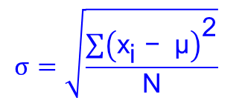
Standard Deviation Variation
3. Sum all squared differences
$\sum{{\left({\text{x}}_{\text{i}} \text{−} \text{μ}\right)}^{\text{2}}}$=
2082.6777 + 1817.8595 + 0.1322 + 1.8595 + 54.2231 + 107.4050 + 129.1322 + 152.8595 + 206.3140
+ 236.0413 + 236.0413
= 5,024.5455
Note that this is the sum of the unrounded squared differences.
4. Divide the summation by the number of data values
$\frac{\sum{{\left({\text{x}}_{\text{i}} \text{−} \text{μ}\right)}^{\text{2}}}}{\text{N}}$ = $\frac{\text{5024.5455}}{\text{11}}$ = 456.7769
5. Calculate the square root of the result
$$\sqrt{\frac{\sum{{\left({\text{x}}_{\text{i}} \text{−} \text{μ}\right)}^{\text{2}}}}{\text{N}}}\text{=} \sqrt{\text{456.7769}}\text{ = }\text{21.4}$$
Notes:
3. Sum the squared differences. [click] Note that the sum shown is calculated using the unrounded values (and so the total is slightly different than the total you get when adding the rounded numbers). If you use the rounded squared differences, the sum is nearly the same 5024.53.
4. Divide the sum by the number of data values. [click] Remember to use the unrounded result from the previous step (even though it does not matter in this case).
5. Take the square root of the division. [click] Remember to use the unrounded result from the previous step.
Report the standard deviation to one more digit than the original data.

Slide 24
Histogram Distribution
A histogram is a common data distribution chart that is used to show the frequency with which specific values, or values within ranges, occur in a set of data.
An engineer might use a histogram to show the variation of a dimension that exists among a group of parts that are intended to be identical.

Slide 25
Histogram Distribution
Large sets of data are often divided into a limited number of groups. These groups are called class intervals.
-16 to -6
-5 to 5
6 to 16
Class Intervals

Slide 26
Histogram Distribution
The number of data elements in each class interval is shown by the frequency, which is indicated along the Y-axis of the graph.
7
5
Frequency
3
1
-16 to -6
-5 to 5
6 to 16

Slide 27
Histogram Distribution
Example
1, 7, 15, 4, 8, 8, 5, 12, 10
1, 4, 5,
7, 8, 8, 10,
12,15
4
3
Frequency
0.5 < x ≤ 5.5
5.5 < x ≤ 10.5
10.5 < x ≤ 15.5
2
1
1 to 5
6 to 10
11 to 15
0.5
5.5
10.5
15.5
Notes:
Let’s create a histogram to represent this data set. [click]
From this example, we will break the data into ranges of 1 to 5, 6 to 10, and 11 to 15. We will place labels on the x-axis to indicate these ranges. [click] Again, these ranges of values are referred to as class intervals.
Note that the class intervals should include all the values along the x-axis. Therefore, the class intervals are technically as follows:
0.5 < x ≤ 5.5 [click]
5.5 < x ≤ 10.5 [click]
10.5 < x ≤ 15.5 [click]
For simplicity we indicate only whole numbers since all of the data values fall within the intervals shown.
Let’s reorder the data to make it easier to divide into the ranges. [click]
[click]

Slide 28
Histogram Distribution
The height of each bar in the chart indicates the number of data elements, or frequency of occurrence, within each range.
1, 4, 5,
7, 8, 8, 10,
12,15
4
3
Frequency
2
1
1 to 5
6 to 10
11 to 15
Notes:
The height of each bar in a histogram indicates the number of data elements, or frequency of occurrence, within each range.
Now, looking at the data, you can see there are three data values in the set that are in the range 1 to 5. [click]
There are four data values in the range 6 to 10. [click]
And there are three data values in the range 11 to 15. [click]
Note that you can always determine the number of data points in a data set from the histogram by adding the frequencies from all of the data ranges. In this case we add three, four, and two to get a total of nine data points.

Slide 29
Histogram Distribution
0.7495 < x ≤ 0.7505
MINIMUM = 0.745 in.
MAXIMUM = 0.760 in.
Notes:
This histogram represents the length of 27 nearly identical parts. The minimum measurement was 0.745 in. [click] and the maximum length measurement was 0.760 inches. Each data value between the min and max fall within one of the class intervals on the horizontal (x-) axis.
Note that in this case, each value indicated on the horizontal axis actually represents a class interval - a range of values. For instance, 0.745 represents the values 0.7445 < x ≤ 0.7455. In general, the interval endpoints should have one more decimal place than the data values. Due to the precision of the measurement device, the data are recorded to the thousandth (e.g. 0.745) and will therefore correspond to one of the values shown on the axis. [click]
The bars are drawn to show the number of parts that have a length within each interval – the frequency of occurrence. For instance, of the 27 parts, two have a length of 0.746 in. (and therefore fall within the 0.7455< x ≤ 0.7465 class interval). [click] Four have a measured length of 0.750 in. (and fall within the 0.7495< x ≤ 0.7505 class interval). [click]

Slide 30
Dot Plot Distribution
0
3
-1
-3
3
2
1
0
-1
-1
2
1
0
1
-1
-2
1
2
1
0
-2
-4
0
0
-6
-5
-4
-3
-2
-1
0
1
2
3
4
5
6
Notes:
Another way to represent data is a dot plot. A dot plot is similar to a histogram in that it shows frequency of occurrence of data values.
To represent the data in the table, we place a dot for each data point directly above the data value. [click]
There is one dot for each data point. [click many times]

Slide 31
Dot Plot Distribution
0
3
-1
-3
3
2
1
0
-1
-1
2
1
0
1
-1
-2
1
2
1
0
-2
-4
0
0
5
Frequency
3
1
-6
-5
-4
-3
-2
-1
0
1
2
3
4
5
6
Notes:
Dot plots are easily changed to histograms by replacing the dots with bars of the appropriate height indicating the frequency. [click]

Slide 32
Normal Distribution Distribution
Bell shaped curve
Frequency
-6
-5
-4
-3
-2
-1
0
1
2
3
4
5
6
Data Elements
Notes:
In a later presentation, we will talk about the distribution of the data, that is, we will look at how the data values are distributed among all the possible values of the variable. Specifically, we will talk about a normal distribution or bell curve.

