Slide 1
Dial Caliper
Description and Use
Introduction to Engineering Design
© 2012 Project Lead The Way, Inc.

Slide 2
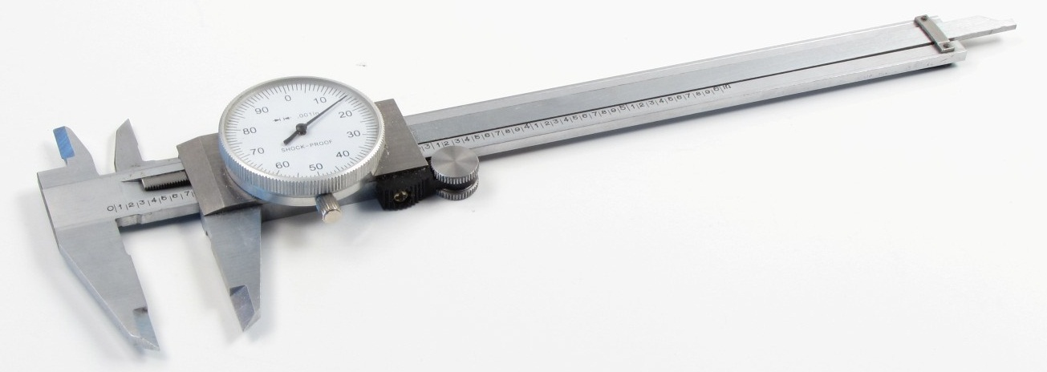
Dial Caliper
Dial Calipers are arguably the most common and versatile of all the precision measuring tools used by engineers and manufacturers

Slide 3
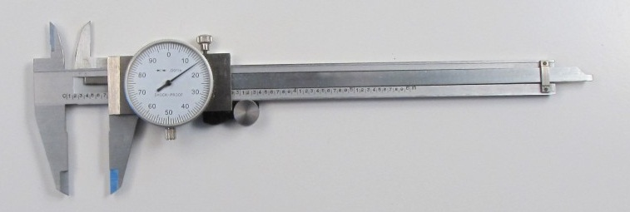
Dial Caliper Measurement
Four Measurements
Outside Diameter or Object Thickness
Inside Diameter or Space Width
Step Distance
Hole Depth

Slide 4
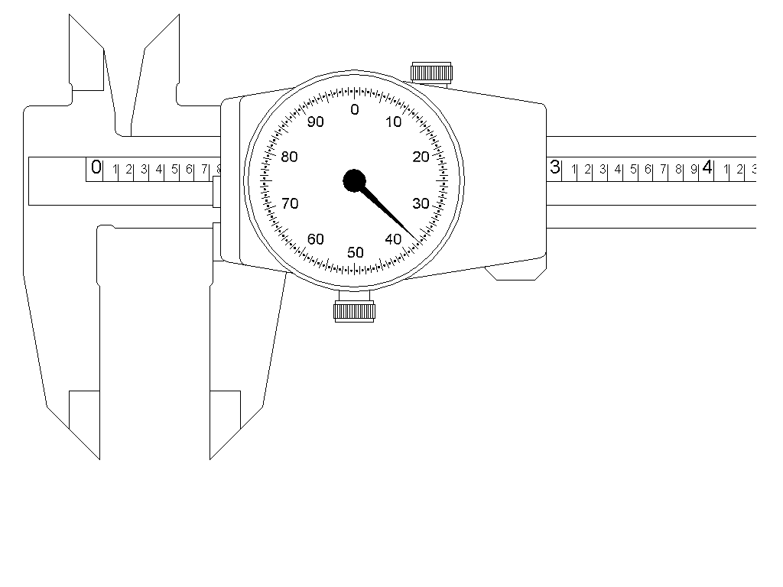
Dial Caliper Limit
Standard inch dial caliper will measure slightly more than 6 inches

Slide 5
Measuring Outside Length
Measurement made between caliper faces shown
Example is outside diameter or object thickness
Outside Measuring Faces

Slide 6
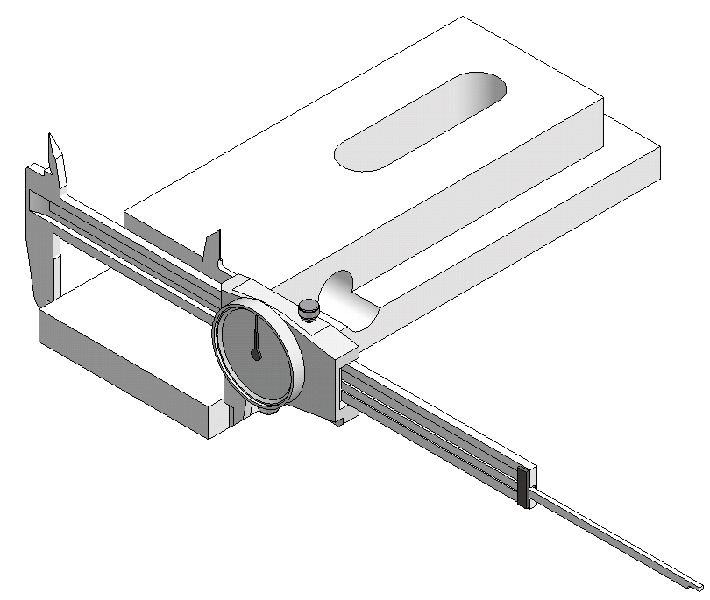
Measuring Outside Length
Example of measuring outside length of object

Slide 7
Measuring Inside Length
Measurement made between caliper faces shown
Example is slot width or hole
Inside Measuring Faces

Slide 8
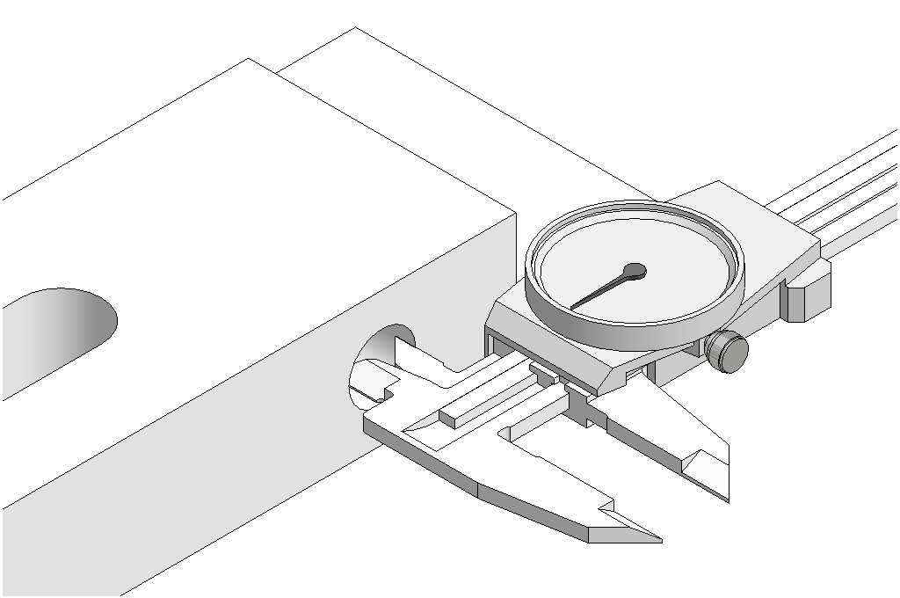
Measuring Inside Length
Example of measuring inside diameter

Slide 9
Measuring Stepped Length
Measurement made between caliper faces shown
Example is stepped parallel surfaces
Step Measuring Faces

Slide 10
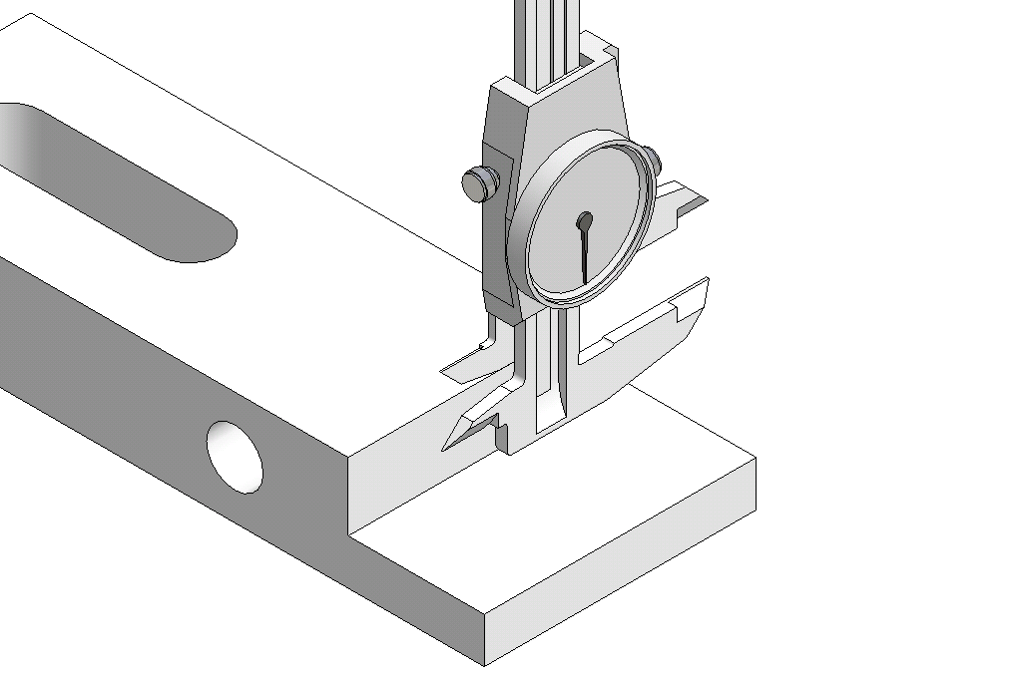
Measuring Stepped Length
Example of measuring step distance

Slide 11
Measuring Depth
Measurement made between caliper faces shown
Example is depth of hole or recess
Depth Measuring Faces

Slide 12
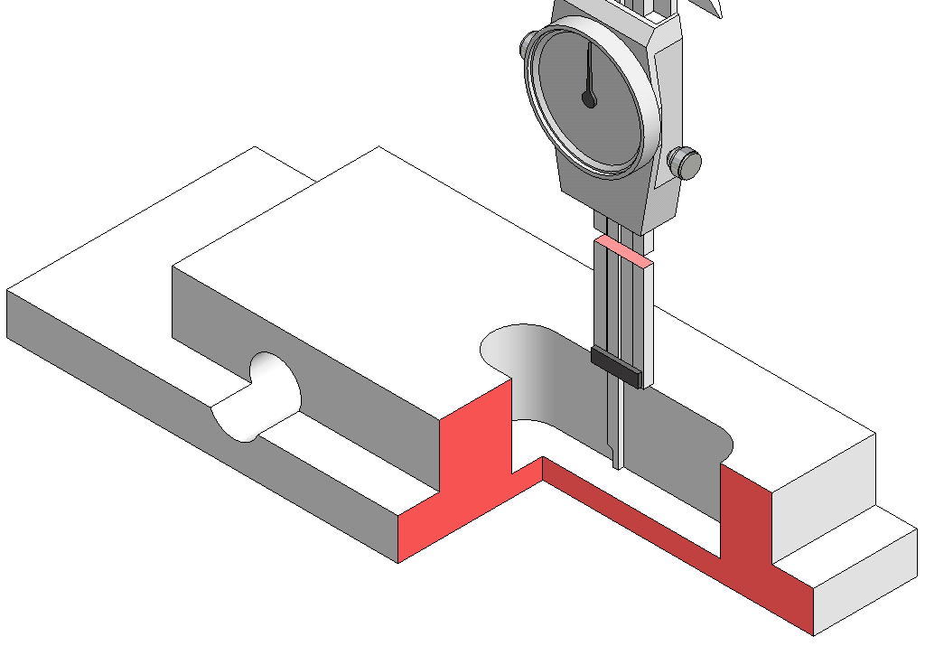
Measuring Depth
Example of measuring depth
Work piece shown as section view
Dial caliper shortened for clarity

Slide 13
Dial Caliper Parts: Blade
Blade is the immovable portion of the dial caliper
Slider moves along blade to adjust the distance between the measuring surfaces
Slider
Blade

Slide 14
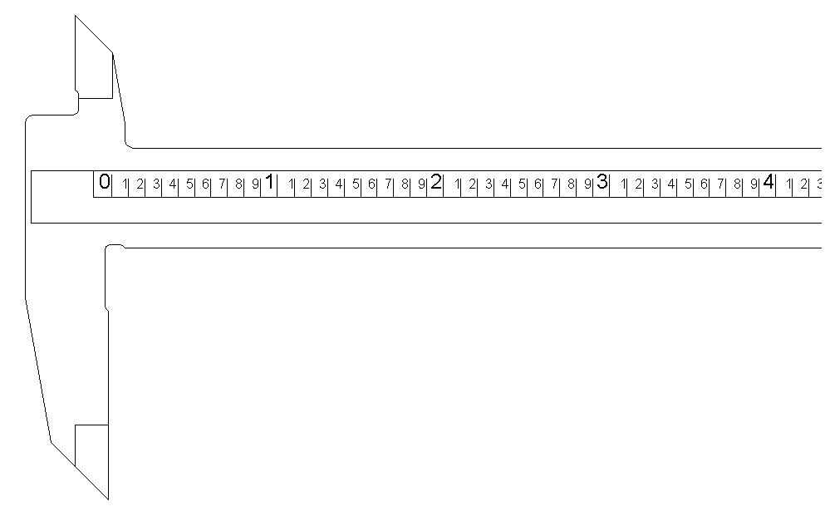
Dial Caliper Parts: Blade
Blade scale divides each inch into 10 increments
Each increment equals one tenth of an inch (0.100 in.)

Slide 15
Dial Caliper Parts: Dial and Pointer
Pointer rotates within the dial as the slider moves back-and-forth along the blade
Dial
Pointer

Slide 16
Dial Caliper Parts: Reference Edge
Reference edge keeps track of larger increments (i.e., 0.100 in.) as the slider moves along the rack
Reference Edge

Slide 17
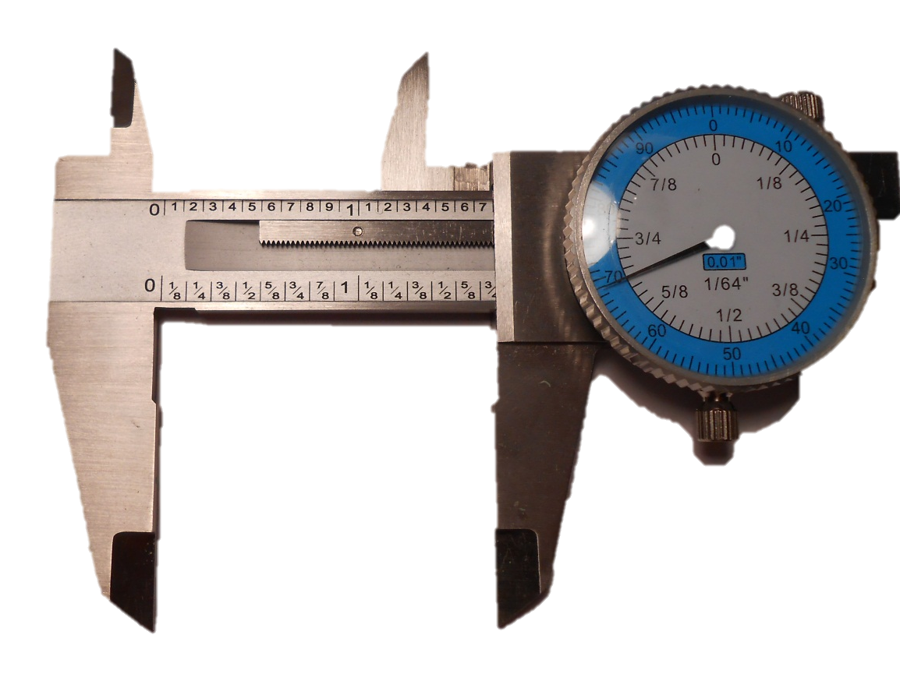
Dial Caliper Parts: Rack
Rear-toothed rack gear is used to change linear motion (slider) to rotary motion (pointer)
Rack

Slide 18
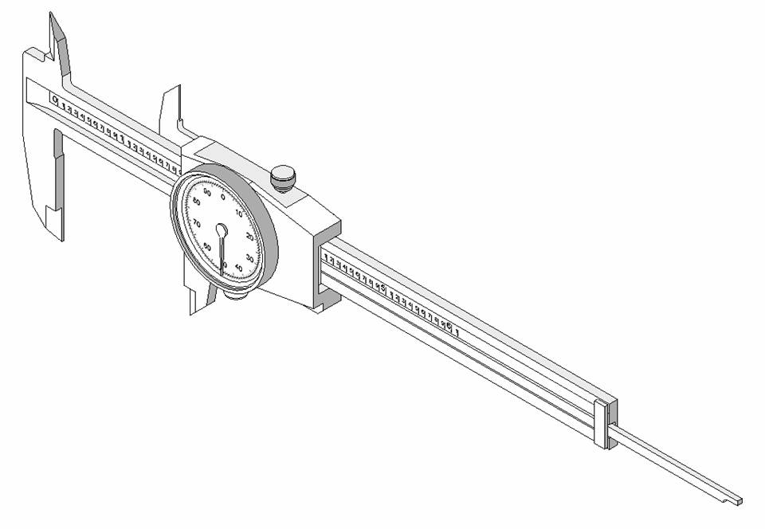
Dial Caliper Interpretation
Accurate dial caliper reading requires several steps

Slide 19
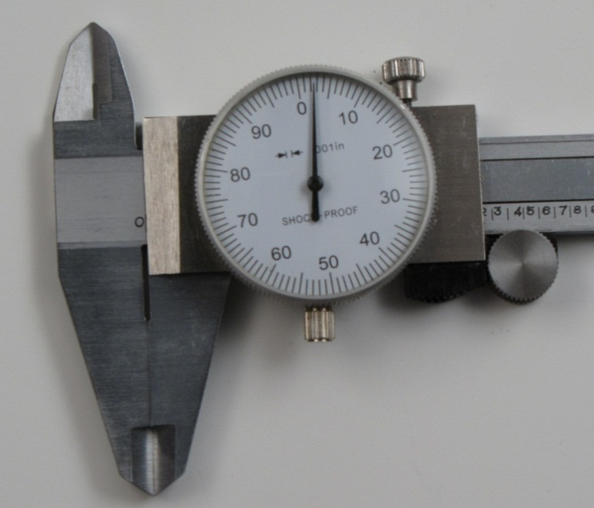
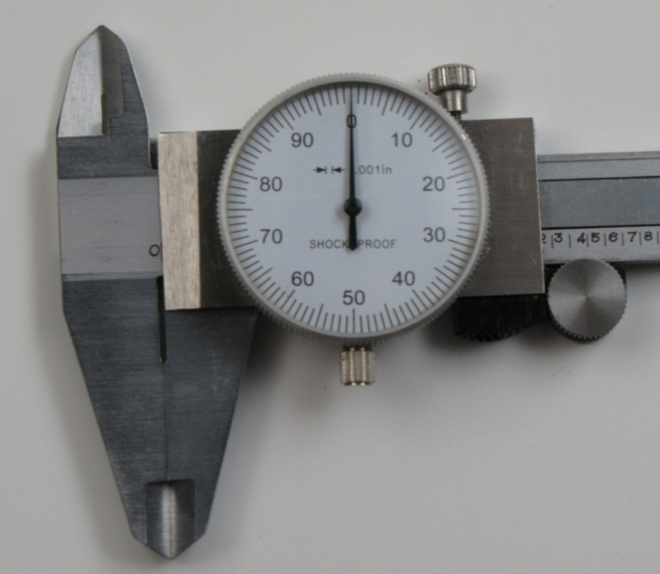
Dial Caliper Interpretation: Zeroing
Before measuring, zero the caliper
Close caliper completely
Loosen dial lock
Rotate dial to read zero
Tighten dial lock
Dial Lock
Zero Alignment

Slide 20
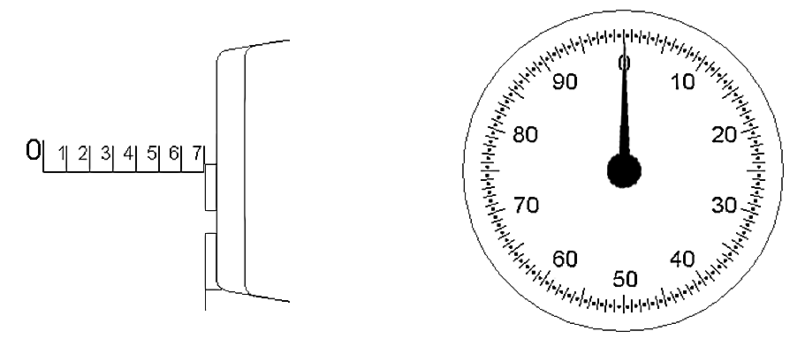
Dial Caliper Interpretation
Each time the pointer completes one rotation within the dial, the reference edge on the slider moves the distance of one blade scale increment (0.100 in.)

Slide 21
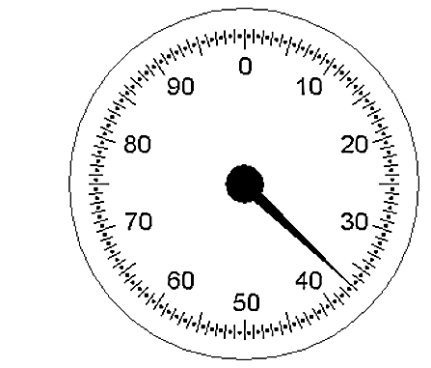
Dial Caliper Interpretation
One revolution of the pointer within the dial represents one tenth of an inch (0.100 in.)
Dial is divided 100 times; therefore, each graduation equals one thousandth of an inch (0.001 in.)

Slide 22
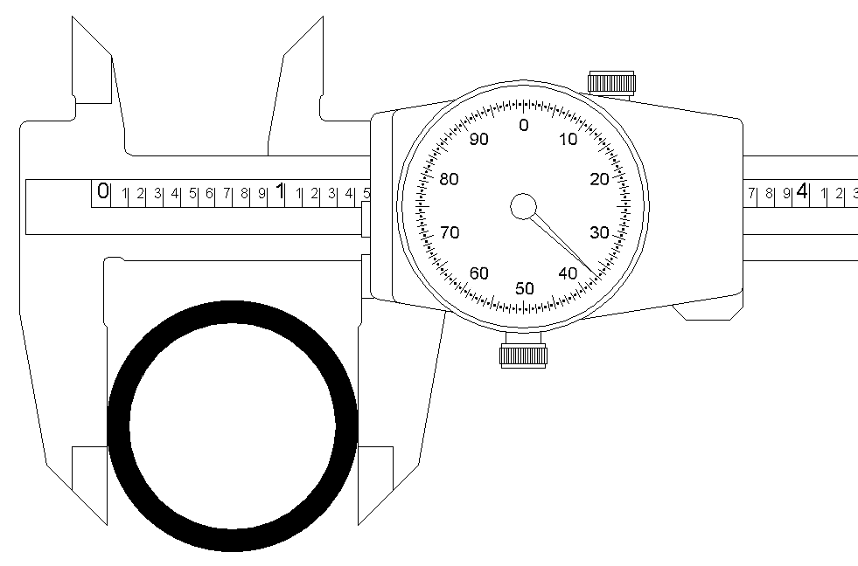
Dial Caliper Interpretation: Practice
To determine the outside diameter of this pipe section
first identify how many inches are being shown on the blade scale

Slide 23
Dial Caliper Interpretation: Practice
Reference edge is located between the 1 and 2 inch marks
Record inch significant digit
1 in. Mark
1.000 in.

Slide 24
Dial Caliper Interpretation: Practice
Identify the 0.1″ increment marks shown to the right of the last inch mark
Record tenth inch significant digit
0.4 in. Mark
1.000 in.
0.400 in.

Slide 25
Dial Caliper Interpretation: Practice
Identify the pointer increment mark shown on the dial
Record thousands inch significant digits
1.000 in.
0.400 in.
0.037 in.
0.037 in. Mark

Slide 26
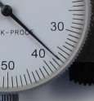
Dial Caliper Interpretation: Practice
Estimate the ten thousands inch significant digit
1.000 in.
0.400 in.
0.037 in.
0.0001 in.
0.0001 in. estimate

Slide 27
Dial Caliper Interpretation: Practice
Add values together for dial caliper measurement
1.000 in.
0.400 in.
0.037 in.
+
0.0001 in.
1.4371 in.

Slide 28
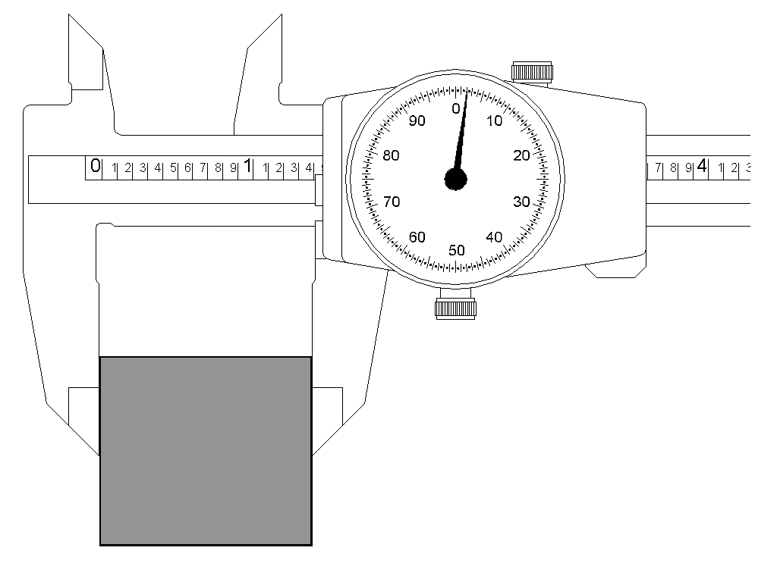
Dial Caliper Interpretation: Practice
How wide is the block?
1.000 in.
0.400 in.
+
0.002 in.
0.0002 in.
1.4022 in.

Slide 29
Dial Caliper Interpretation: Practice
Complete Activity 3.4 Making Measurements

