Slide 1
Line Conventions
Introduction to Engineering Design
© 2012 Project Lead The Way, Inc.

Slide 2
Line Conventions
Lines of varying style and thickness are used in specific ways to develop and communicate graphic messages about an object’s geometry. The next few slides show some basic line conventions and their use.

Slide 3
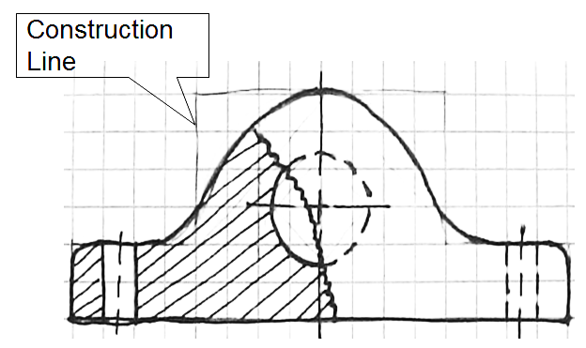
Construction Line
Very lightly drawn lines to guide drawing other lines and shapes

Slide 4
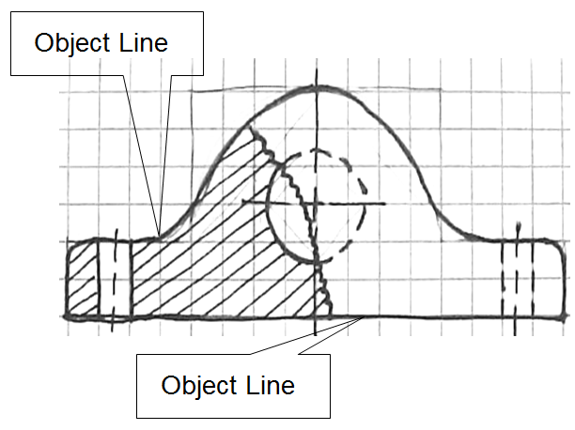
Object Line
Thick and dark
Define the object

Slide 5
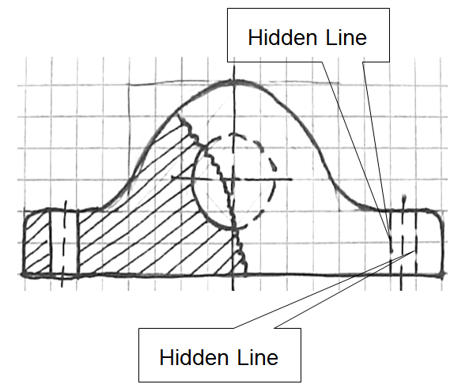
Hidden Line
Show interior detail not visible from the outside of the part

Slide 6
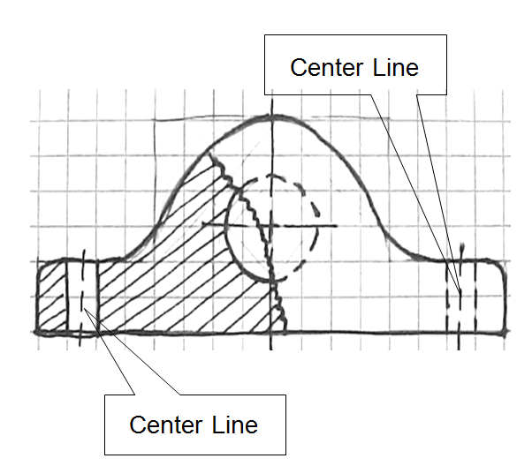
Center Line
Define the center of arcs, circles, or symmetrical parts
Half as thick as an object line

Slide 7
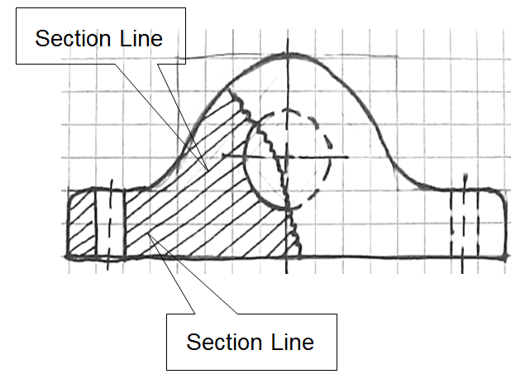
Section Line
Define where material is cut away

Slide 8
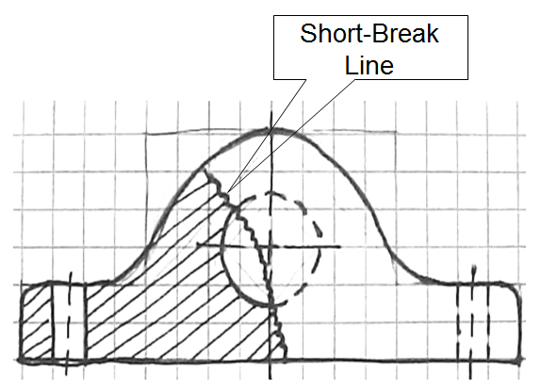
Short-Break Line
Freehand drawn line
Shows where part is broken to reveal detail behind the part or to shorten a long continuous part

Slide 9
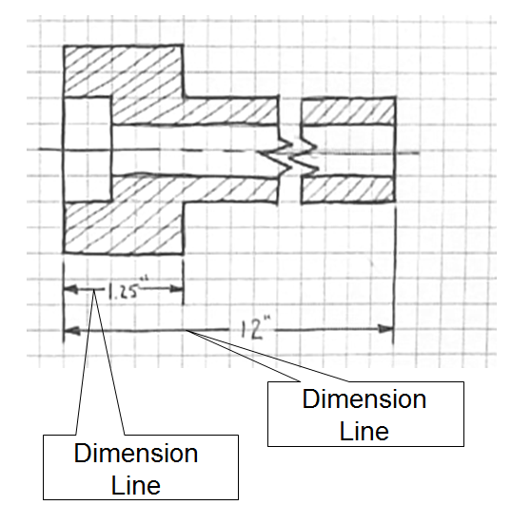
Dimension Line
Shows distance
Arrows drawn on ends to show where dimension line starts and ends
Actual distance is typically located in middle of this line to display distance

Slide 10
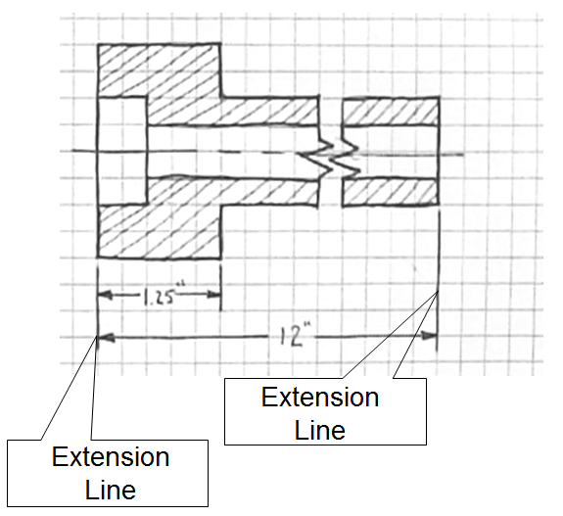
Extension Line
Shows where a dimension starts and stops
Used with dimension lines
Line is 1/16” away from part to avoid confusion with object lines

Slide 11
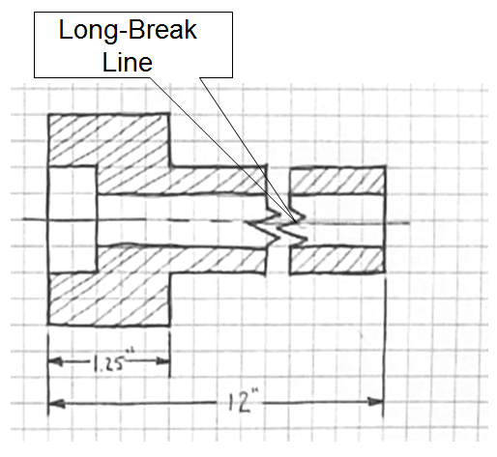
Long-Break Line
Shorten very long objects with uniform detail
Typically represented as a jagged cut or break

Slide 12
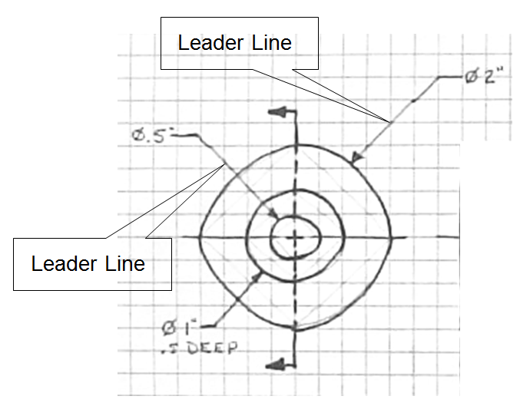
Leader Line
Show dimensions of arcs, circles, and detail

Slide 13
Line Conventions
These standards relate to technical drawing (more precise than freehand sketching).
Use these standards as a guide when sketching.

Slide 14
Precedence of Lines
Complex object sketches may require different line types to overlap.
Line precedence must be used.
Rules that govern line precedence in sketches and technical drawings
Object lines take precedence over hidden and center lines.
Hidden lines take precedence over center lines.
Cutting plane lines take precedence over all others.

Slide 15
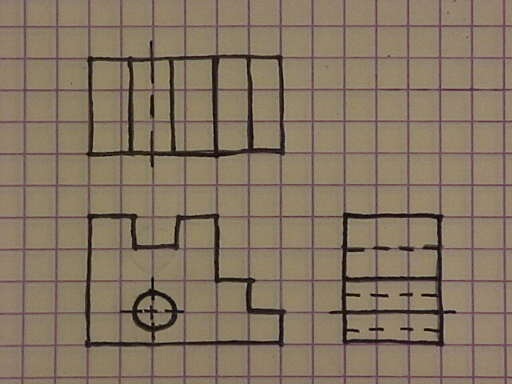
Precedence of Lines Examples
Object lines have precedence over hidden lines
Object line has
precedence over center line.

